Slide 1
BNSF: Remote Control Locomotives

Slide 2
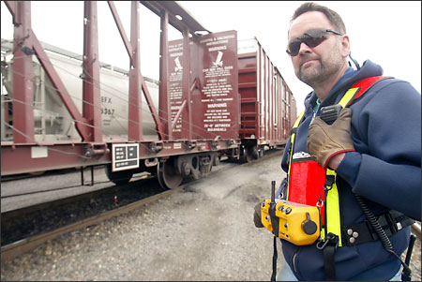
Introduction
What are Remote Control Locomotives?

Slide 3
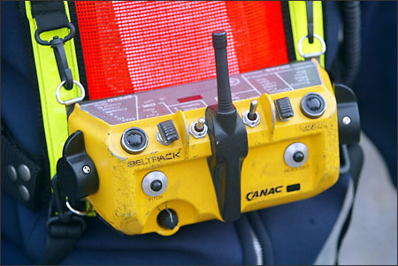
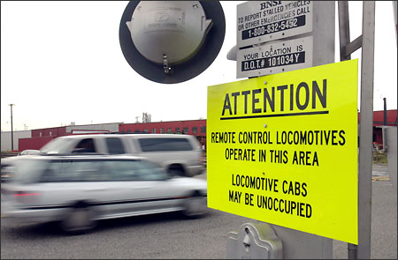
History: Is it safe?
Spotter and Conductor
Safety Features
Use in Canada
U.S. Training Requirements and Implementation

Slide 4


Labor Disputes Over RCL
The Brotherhood of Locomotive Engineers (BLE) and the AFL-CIO vs. the United Transportation Union (UTU) and the Association of American Railroads (AAR)

Slide 5
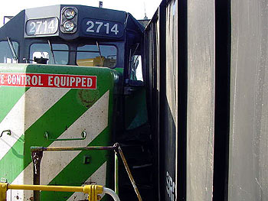
Brotherhood of Locomotive Engineers: Tactics
Lobbied for RCL denouncements from city and state officials. (Detroit)
BLE website shows numerous photos of minor (2-3 car) RCL train derailments.
Moving to federal level in recent months.

Slide 6
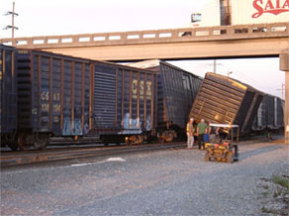
Source: BLE Website

Slide 7
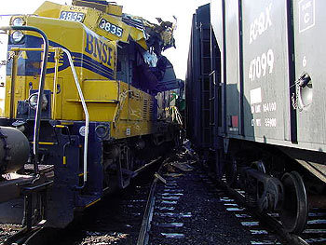
Source: BLE Website

Slide 8

Policy Hurdles
H.R. 2843
(2) The Nation's freight rail system is relatively open to outside access when compared to the aviation system. Security is provided almost solely by private railroad carriers, and terrorists could easily gain access to a remote control locomotive or an operator control unit and then operate a remote control transmitter controlling a remote control locomotive.
(3) Remote control locomotives carrying hazardous materials in urban areas could be sabotaged or remote control locomotives could be used to cause intentional accidents with other trains, causing loss of life, release of hazardous materials, and the disruption of interstate and international commerce.
(4) Therefore, the risk of terrorists hijacking remote control locomotive operations is far too great in situations where remote control locomotives are carrying hazardous materials.[1]
[1] H.R. 2843, 109th Congress. 1st Session. Introduced: June 9, 2005.
Gene Green (D-TX) has received 75% of his total campaign contributions from Labor in the 2005-2006 election cycle.

Slide 9
Threat to BNSF from H.R. 2843
Rail is extremely capital-intensive.
RCL is the technology of the future for the rail industry and could cut labor costs.
BLE and AFL-CIO leaders had been trying to protect locomotive engineers’ jobs by highlighting trivial safety problems.
If BLE and AFL-CIO are successful in making the case that RCL technology is a threat to national security, they may be in a much stronger position to delay RCLs.

Slide 10
Tactics for BNSF to Defeat H.R. 2843
1.Target sympathetic members of the House Subcommittee on Railroads in the House Committee on Transportation and Infrastructure.

Slide 11
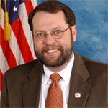
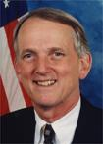
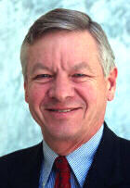

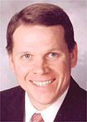
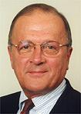
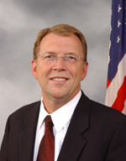

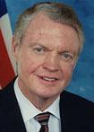
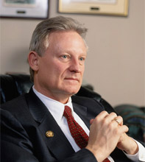

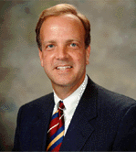
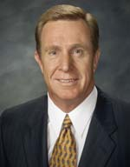
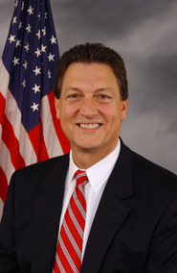
Rob Simmons (R-CT)
Todd Russell Platts (R-PA)
Sam Graves (R-MO)
Jon C. Porter (R-NV)
Tom Osborne (R-NE)
Michael E. Sodrel (R-IN)
Lynn A. Westmoreland (R-GA)
Chairman Steven C. LaTourette (R-OH)
Thomas E. Petri (R-WI)
Sherwood L. Boehlert (R-NY)
John L. Mica (R-FL)
Spencer Bachus (R-AL)
Jerry Moran (R-KS)
Gary G. Miller (R-CA)
TARGETS IN THE RAIL SUBCOMMITTEE

Slide 12
Tactics for BNSF to Defeat H.R. 2843
2. Utilize AAR’s PAC and strong lobbying arm to augment BNSF’s private efforts.
3. Continue to curry favor with industry- publication editorial boards such as Traffic World, as well as contributing op-ed pieces, etc. to main stream media outlets.
4. Remember that RCL is its own best PR-generator. Involve manufacturers of RCL tech, such as GE, in “feel good” T.V. campaigns about its merits and potential for further growth.

